Slide 1

Exploring Surface Processes: How to Build Coupled Models Brainstorm
AGU Workshop 2019
Mark Piper, Nicole Gasparini, Andrew Ashton, Nate Lyons, Irina Overeem

Slide 2
Agenda
8:00 - 8:30 | Welcome, intros, setup
8:30 - 9:30 | Intro to landlab
9:30 - 9:45 | Break
9:45 - 11:00 | Building coupled models with landlab
11:00 - 12:00 | Intro to pymt
12:00 - 13:15 | Lunch
13:15 - 14:30 | Building coupled models with pymt
14:30 - 14:45 | Break
14:45 - 15:15 | Breakouts and brainstorms
15:15 - 15:45 | Future research directions
15.45 – 16:00 | Wrap-up, opportunities for more

Slide 3

Brainstorm: a rain of ideas

Slide 4
Objective of Brainstorm
Identify pressing and innovative research topics in the earth surface processes that can be addressed with plug-and-play modeling

Slide 5
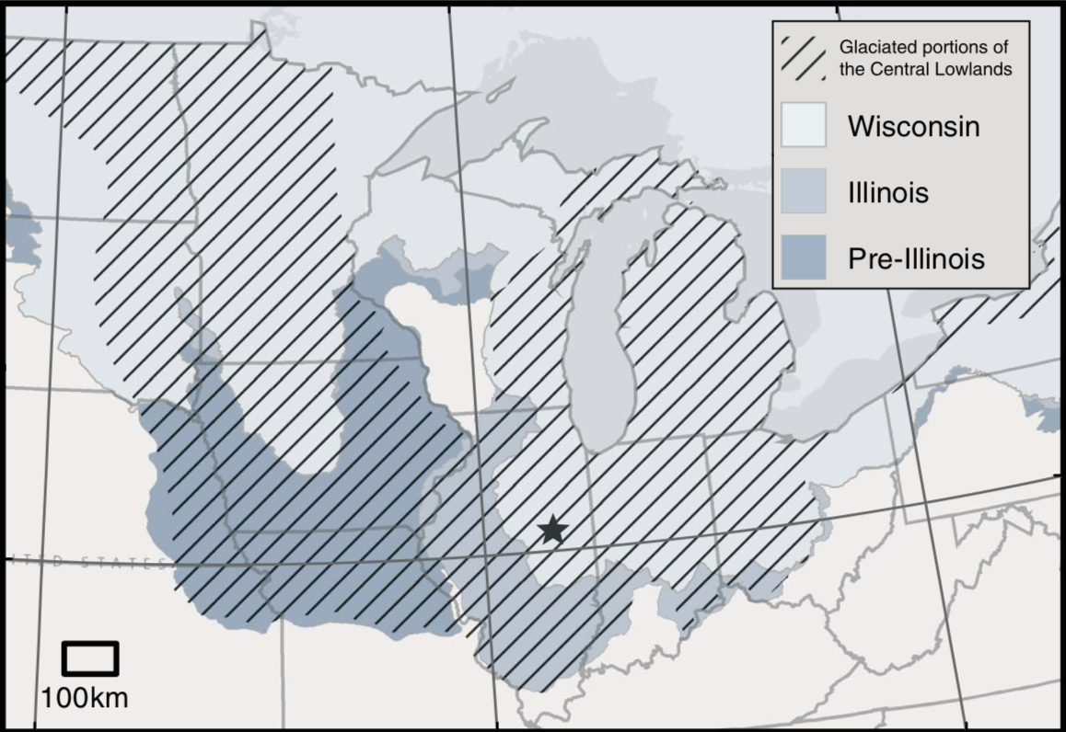
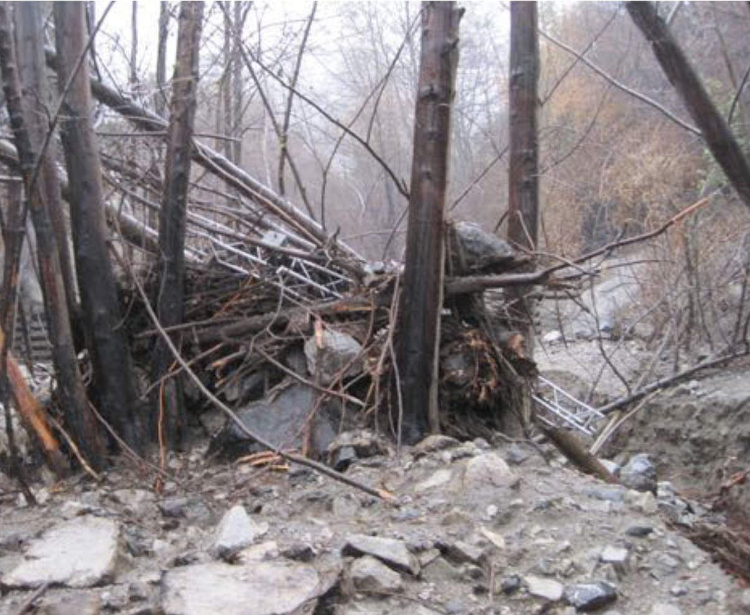
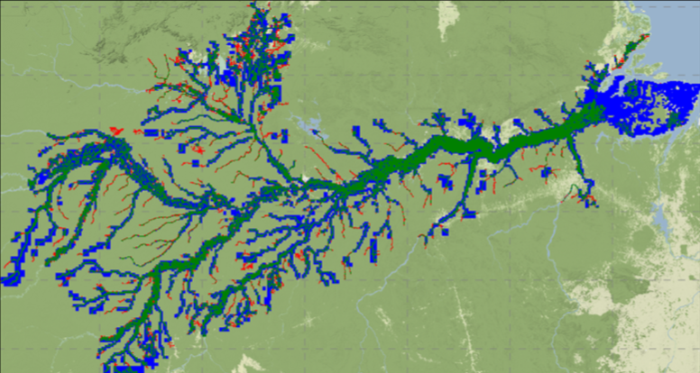
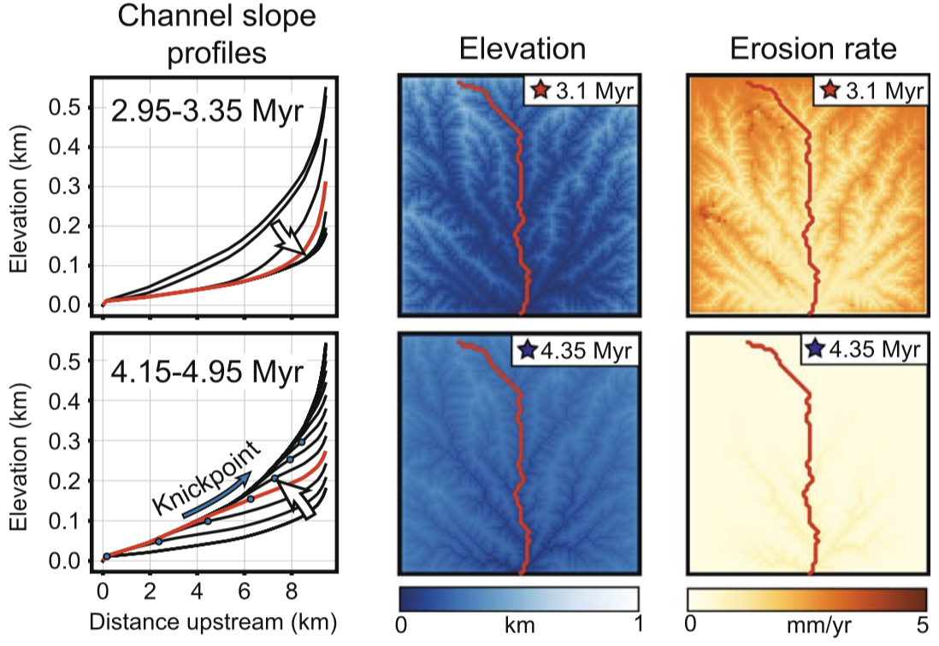
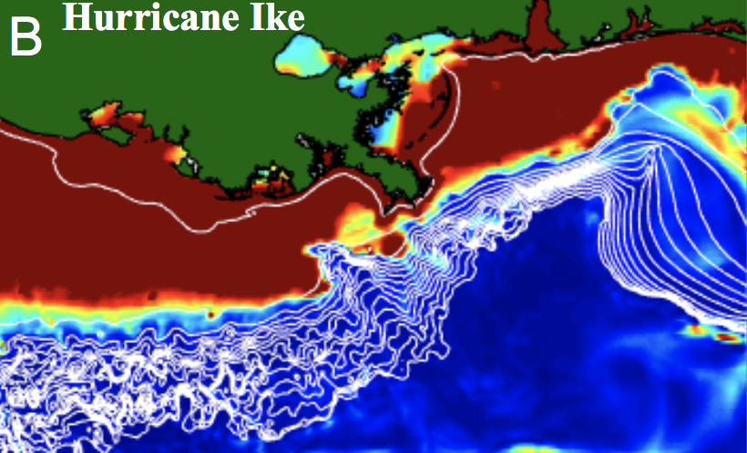
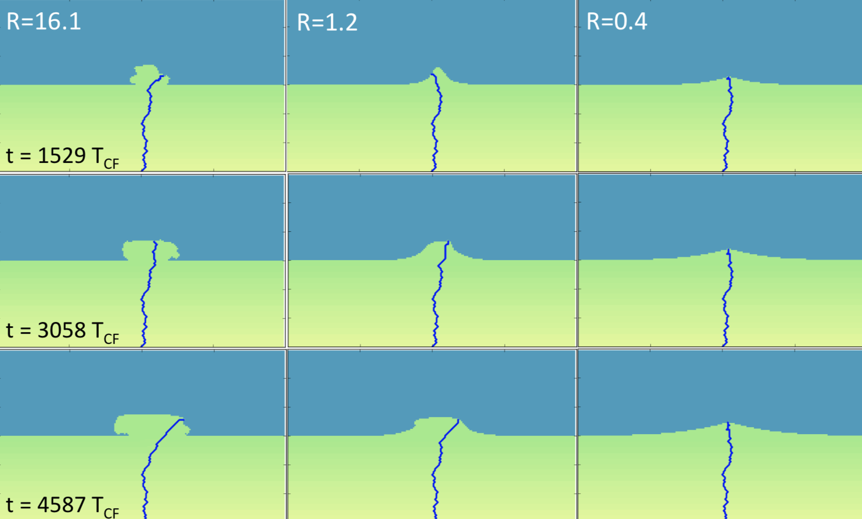
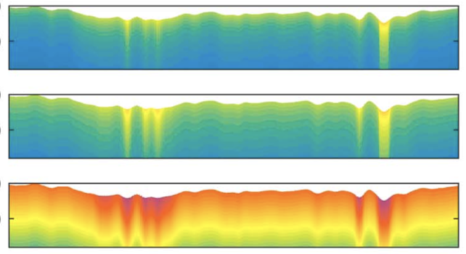
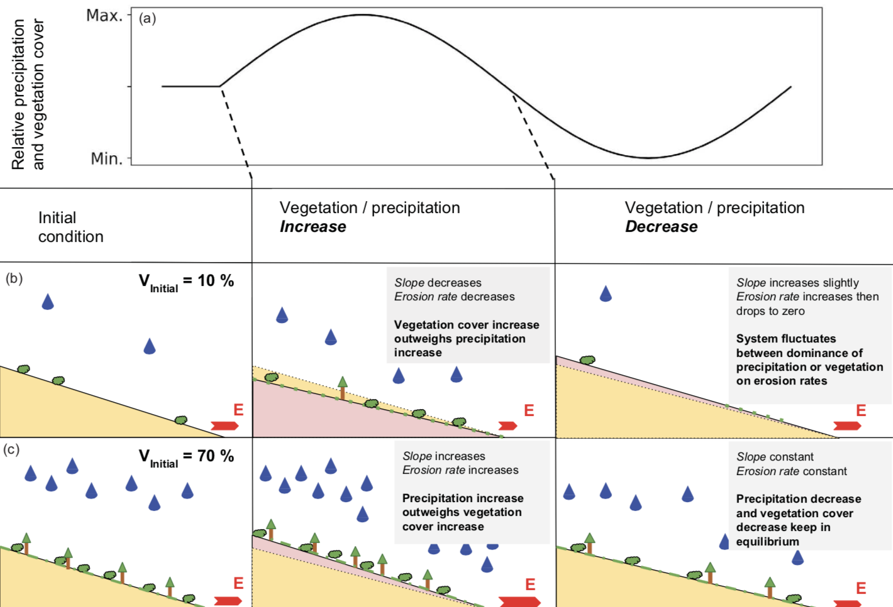
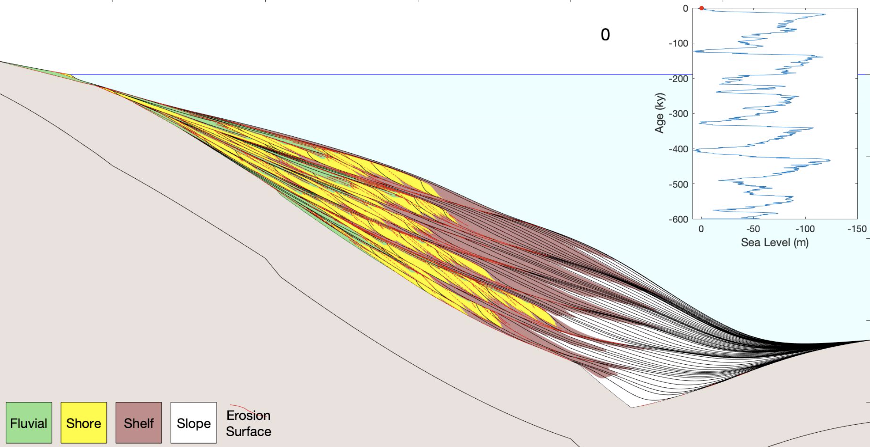
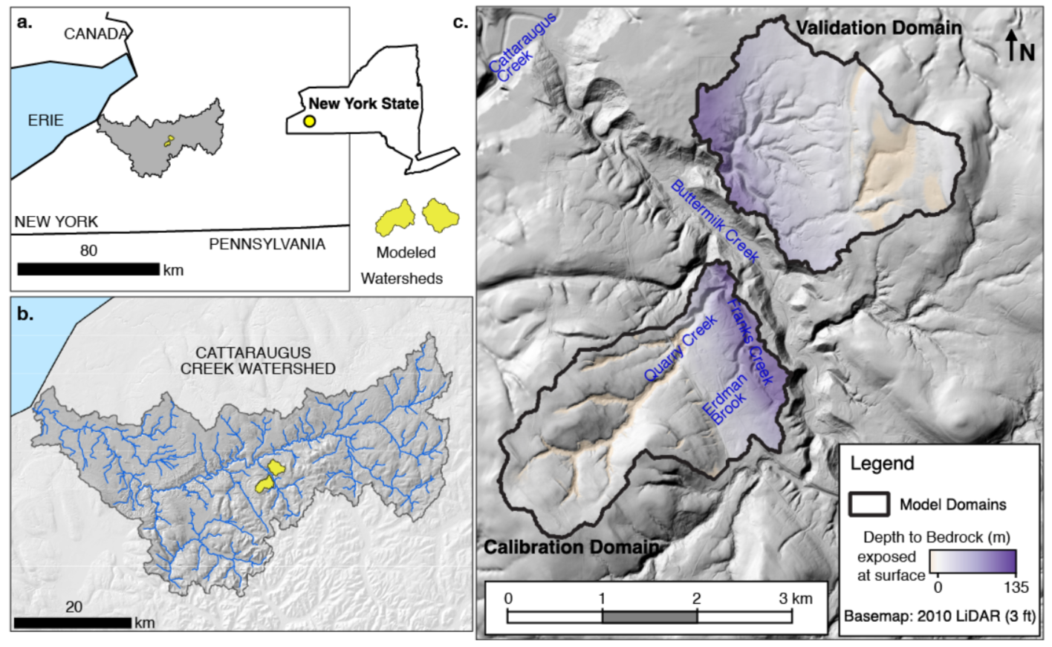
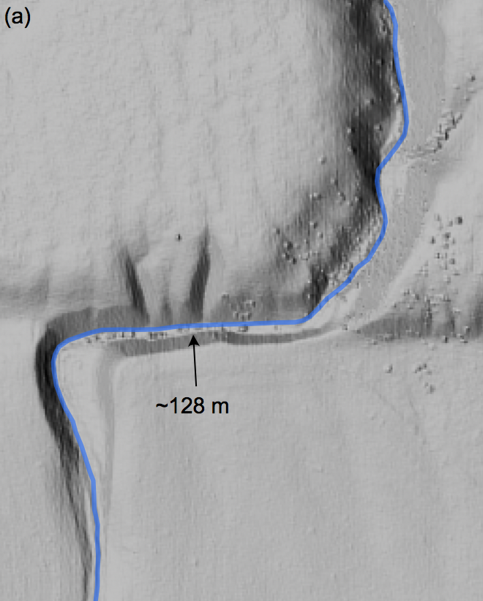
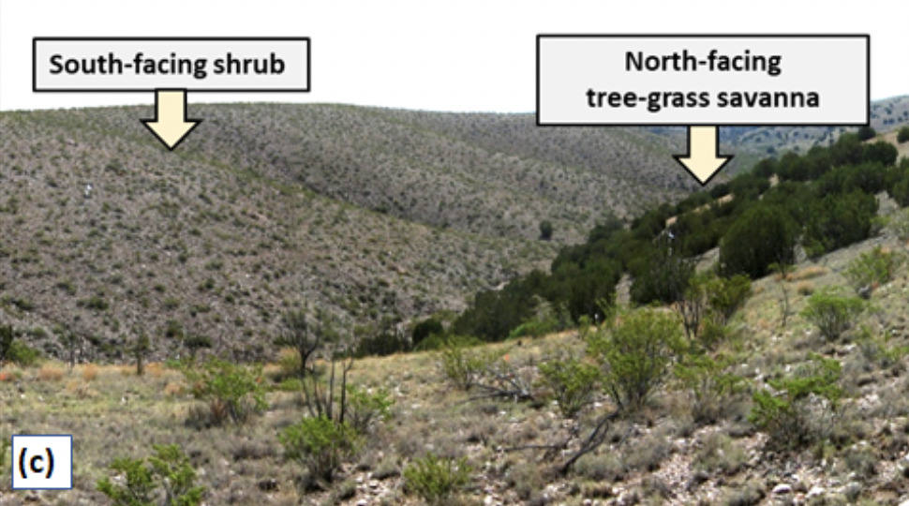
Examples of community research questions*
How do drainage networks form after glaciation?
Can we better predict flood inundation?
How do hurricanes trigger deep-sea turbidity currents?
How do Arctic rivers affect permafrost melt?
How are climate and sea level cycles reflected in marine stratigraphy?
When does stream offset accurately record fault slip?
How can we efficiently predict debris-flow timing?
Can sediment provenance reveal environmental signals in stratigraphy?
How will sea-level rise impact coastal deltas?
How do cycles in climate and vegetation influence landscape evolution?
Can we forecast erosion at hazardous waste sites?
Can changes in grazing and wildfire regime trigger woody plant encroachment?
* addressed using CSDMS technology
Notes:
Applied

Slide 6
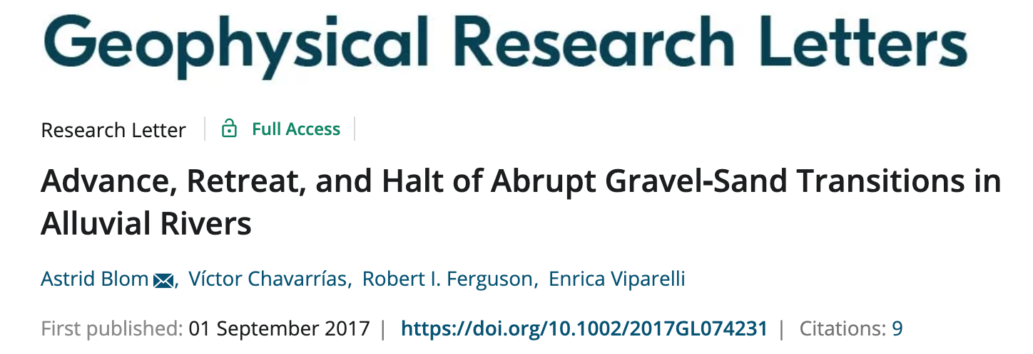
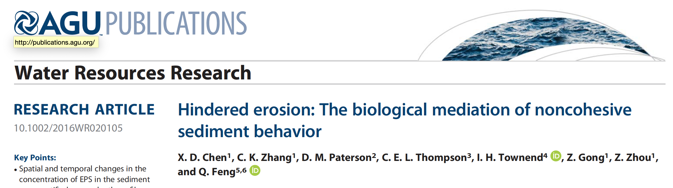
Fundamental sediment transport laws are not sufficient?
Complex mixtures of grainsizes in substrate transport are barely accounted for in models
Polymeric substances, cyanobacteria, algae are efficient sediment binders, and cause flocculation.
But this process is usually not treated in models

Slide 7
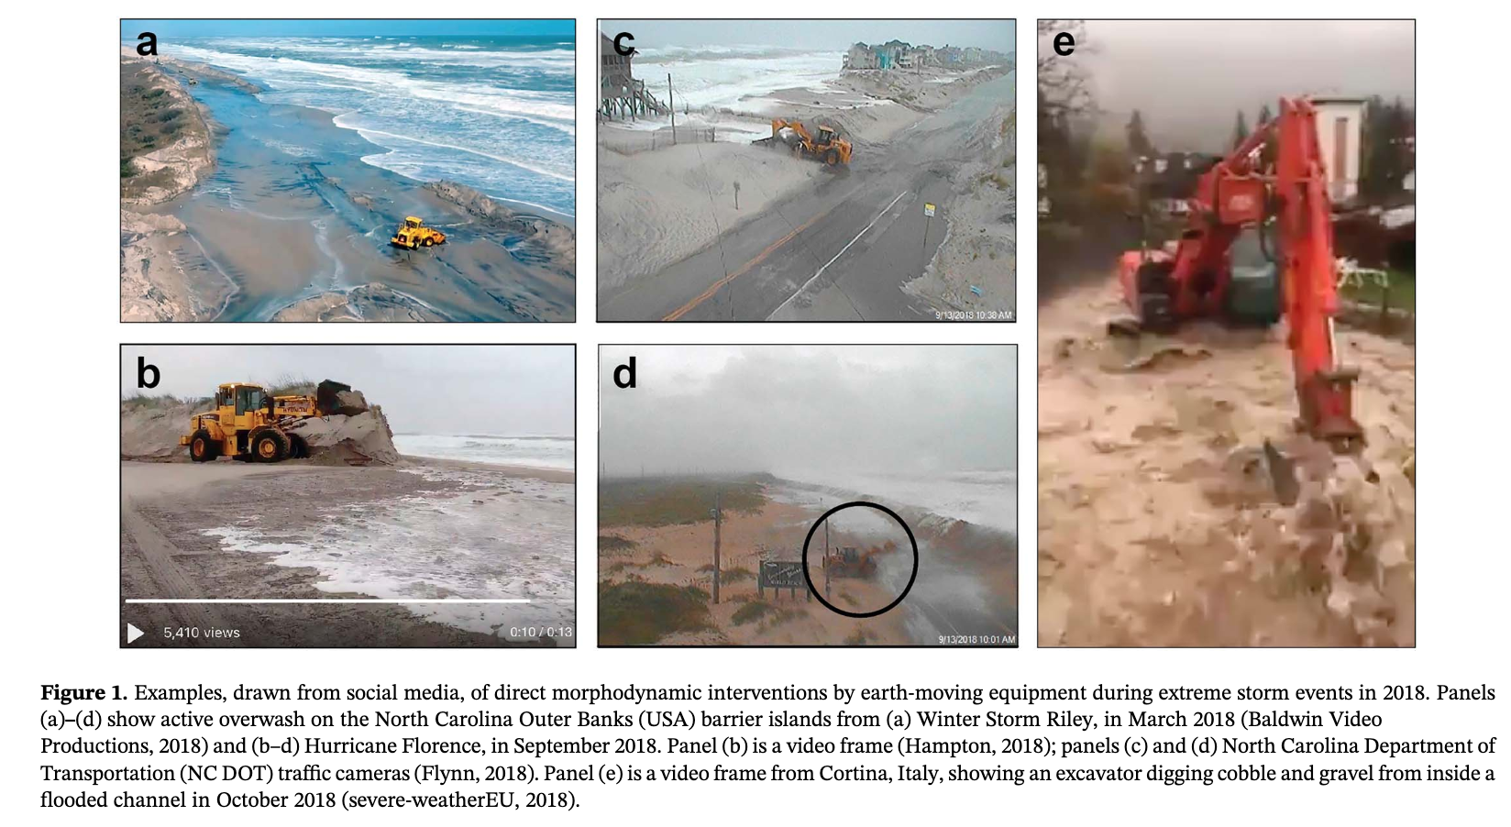
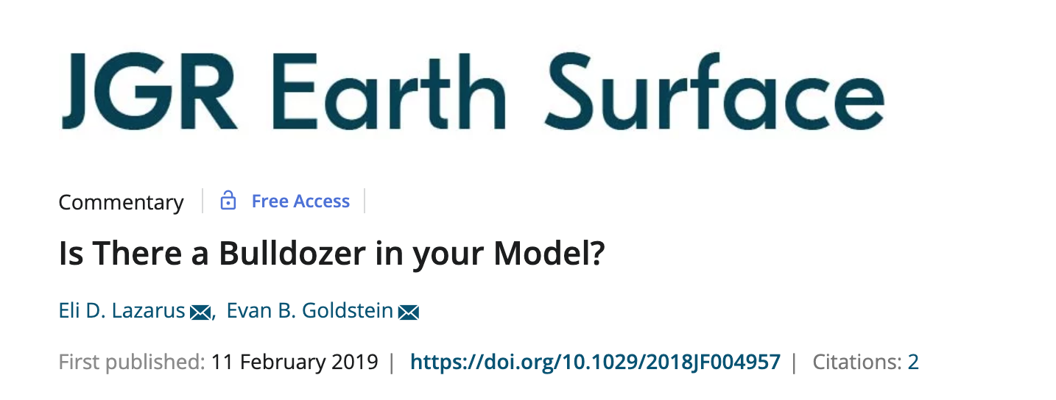
Human Interventions missing at morphodynamics scale…
“Deliberate, real‐time human interventions into geomorphic processes are a phenomenon
no off‐the‐shelf numerical model of morphodynamics is built to capture”
During severe weather events, humans intervene in
surface processes (all depicted are 2018 events)

Slide 8
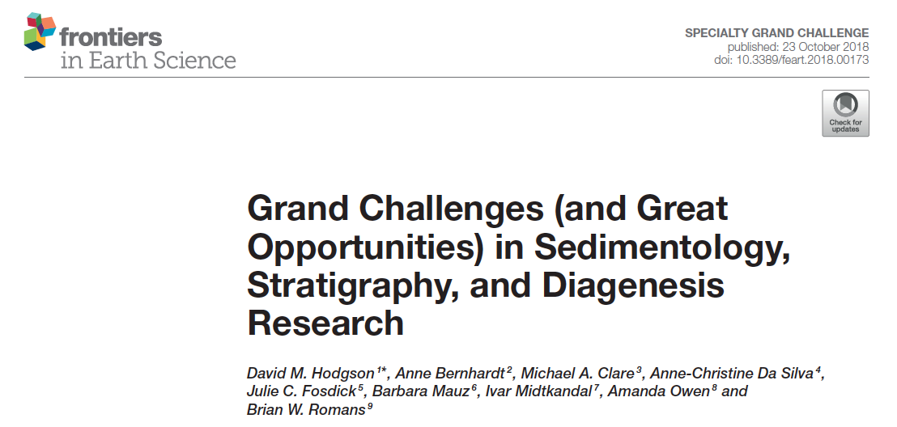
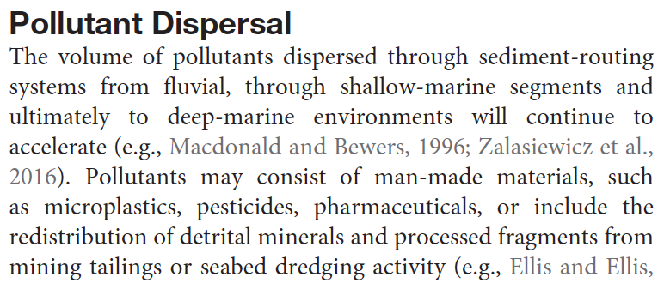
Some thoughts on needs from the stratigraphic community
Example… call to better “tag” carbon and
man-made material in source to sink models

Slide 9
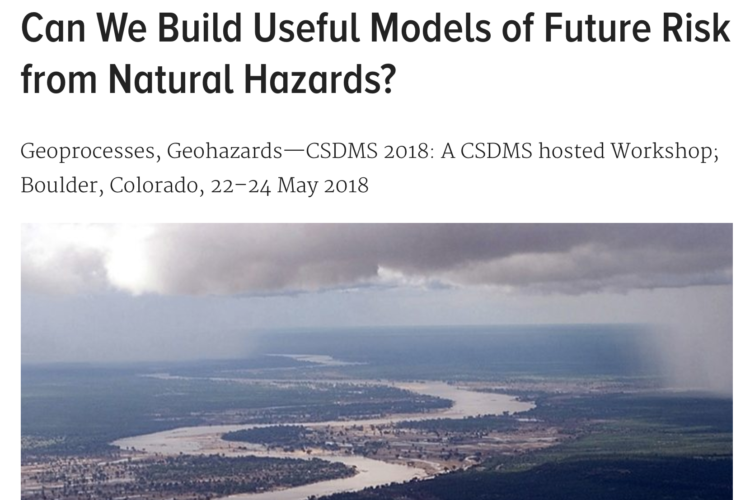
Better model predictions of natural hazards, what holds us back?
Ideally, Earth surface models can contribute to quantitative pre-event risk assessments. But models fall short in several ways…
Extreme events needs to be better accounted for in longterm evolution models, cascading hazards requires coupled process models.
Kettner et al, EOS, 2018

Slide 10
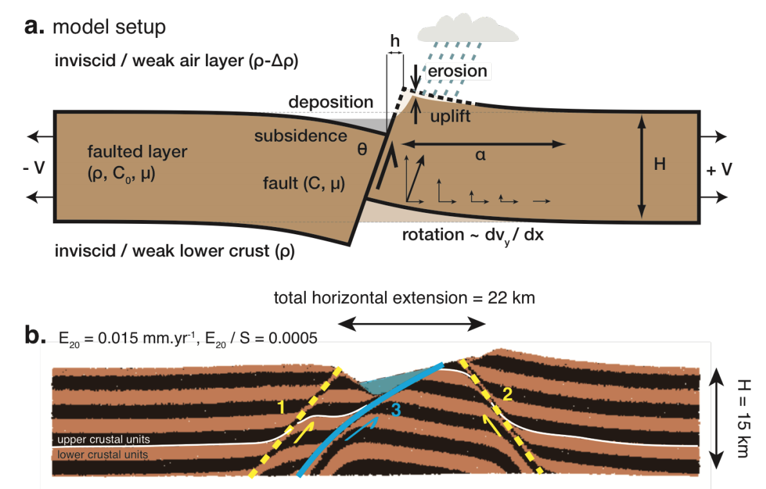
Tectonics and surface processes? Does coupling of these processes matter?
Example: At the scale of individual faults, coupled models such as SiStER demonstrate that the effect of surface processes on fault evolution is to further enhance the fault lifespan in thinner/weaker faulted layers (Olive et al., 2014; Figure 6).
https://csdms.colorado.edu/mediawiki/images/CTSP_WhitePaper_Final.pdf

Slide 11
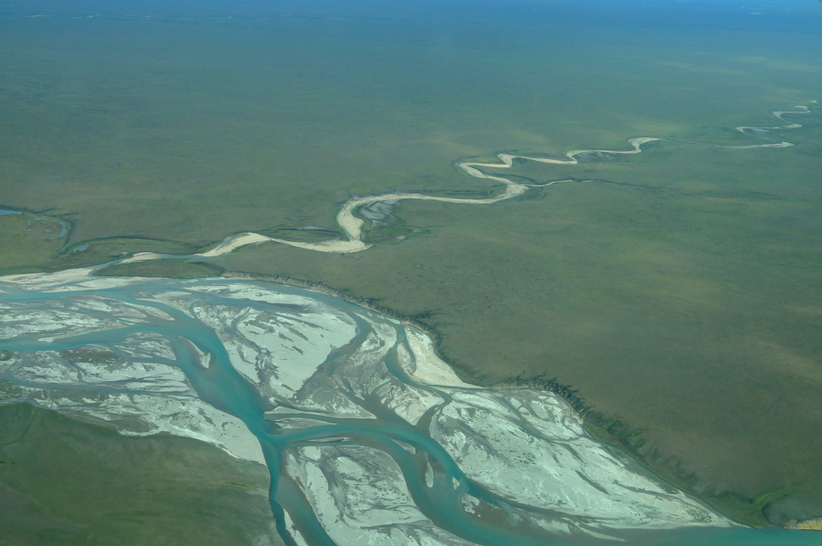
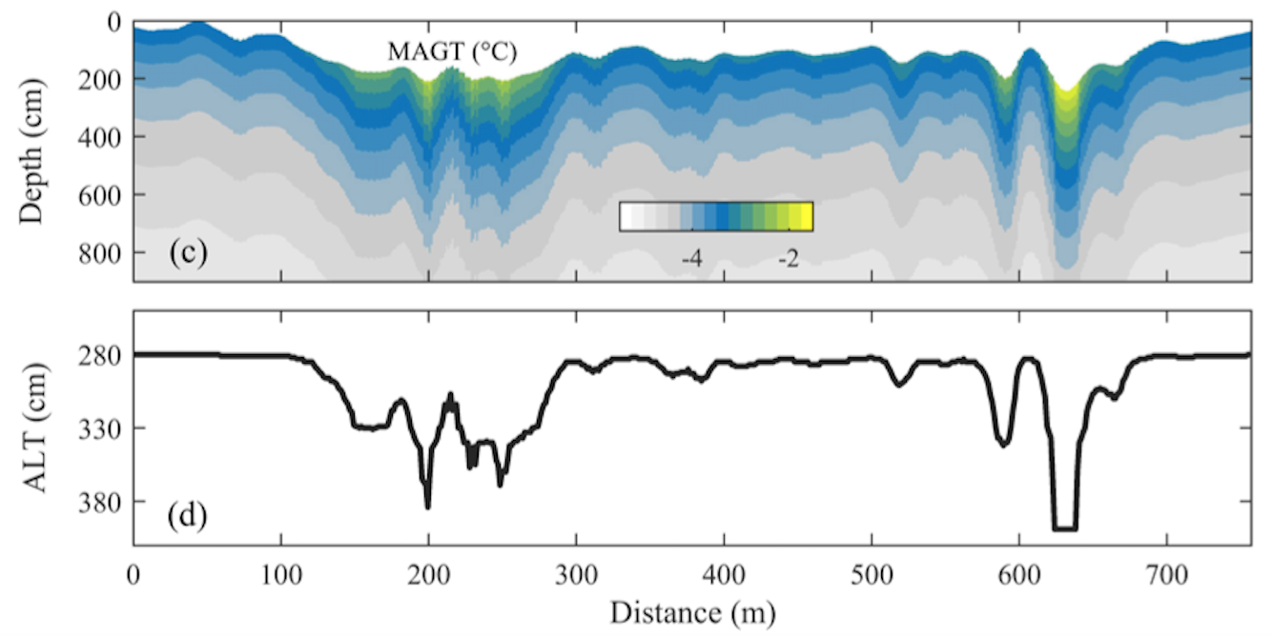
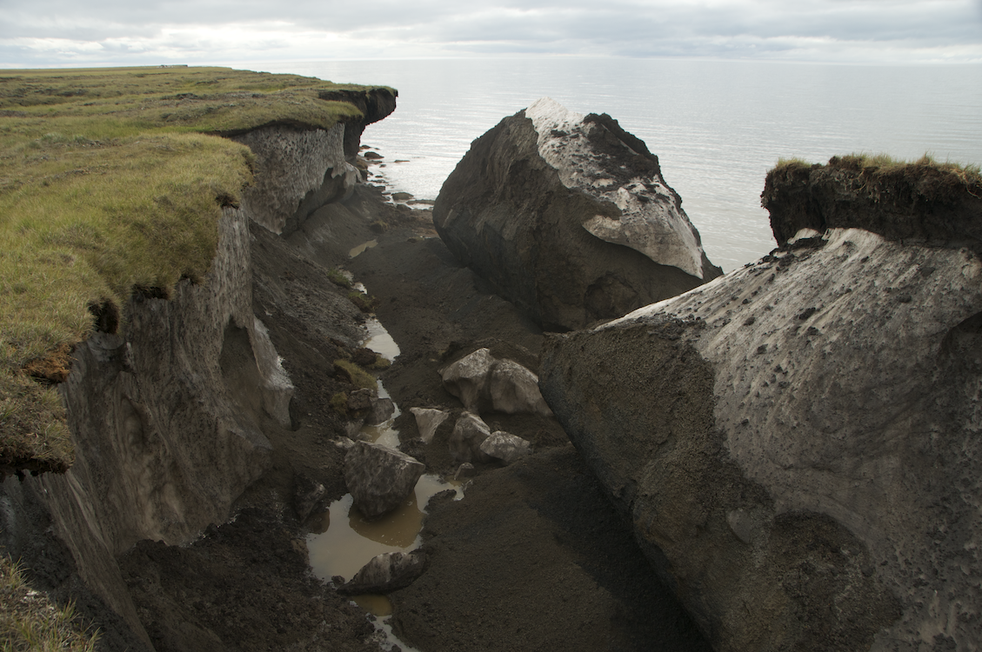
Cryosphere and surface processes?
How do surface processes change in permafrost or glaciated terrain? Erosion can be heat controlled!
Example: River inundation brings heat into Arctic floodplains and drives up the temperature in the subsurface locally (Zheng, 2019)
X-section

Slide 12
Organization
Split into 5 groups: Andrew Ashton, Nicole Gasparini, Mark Piper, Irina Overeem, Nathan Lyons (facilitators)
Each facilitator picks a a notetaker.
Step 1: Everyone in group is introduced to same questions and keywords
Step 2: then everyone is asked to quietly think and jot down ideas by themselves for 5-10 minutes. It is ok to have goofy ideas.
Step 3: join three neighbors or friends, introduce yourselves in 1 min, 10 mins to share ideas
Step 4: all groups of three report on their ideas, discuss it with the whole group

Slide 13
Leading questions on scientific challenges….
What are next frontier fundamental research questions in earth surface processes?
How can modeling of earth surface processes help societal needs?

Slide 14
Leading questions on the tools:
What modeling tools would help towards solving pressing surface dynamics science problems?
What modeling/data analysis tools would be needed to solve your own research questions?
What model should be ‘up next’ to be incorporated into pymt or landlab, and why?
What would be desired features for a next generation of pymt or landlab?

Slide 15
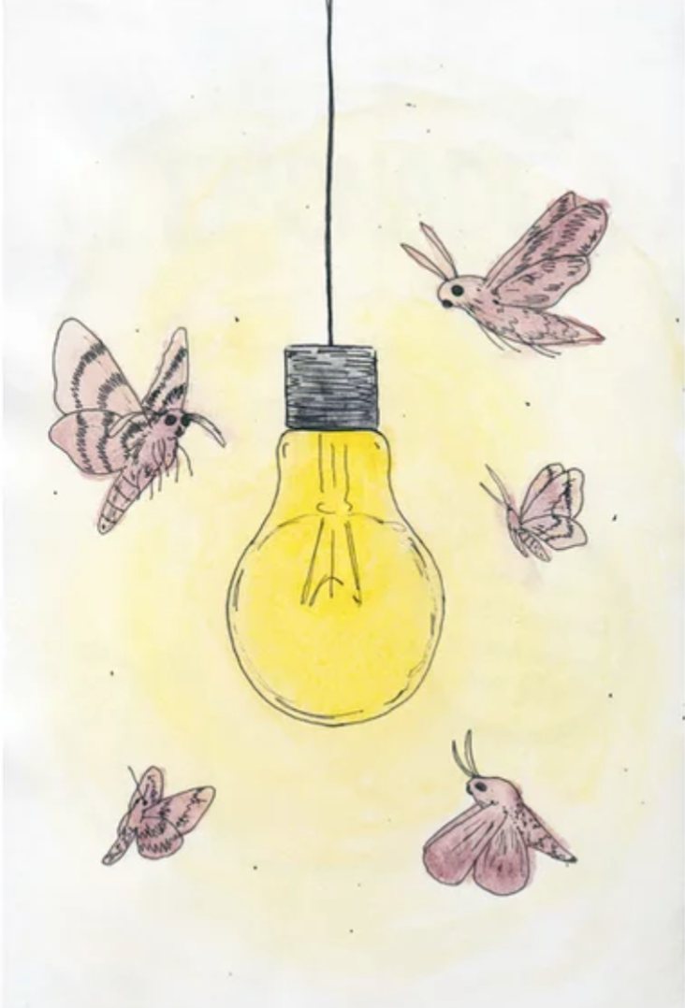
Two mindsets game: use the pens & notepads
MAKE IT HAPPEN
Urgent question?
Feasible goal? Doable with tools around…?
THINK BIG
Stretch goal?
New frontier?
Two ideas will be selected
to be awarded funding
for a visit to Boulder to collaborate with
software engineers at CSDMS

Slide 16
Make it happen….
CSDMS has funding support for two mini teams to work on implementing an idea together at the Integration Facility in Boulder in 2020.
Today, we will collate ideas and then vote forward the two best ones.
The CSDMS team and working group chairs will be in touch to see whether a team can be formed and is interested.
(If not, we will step down to the next team).

